Slide 1

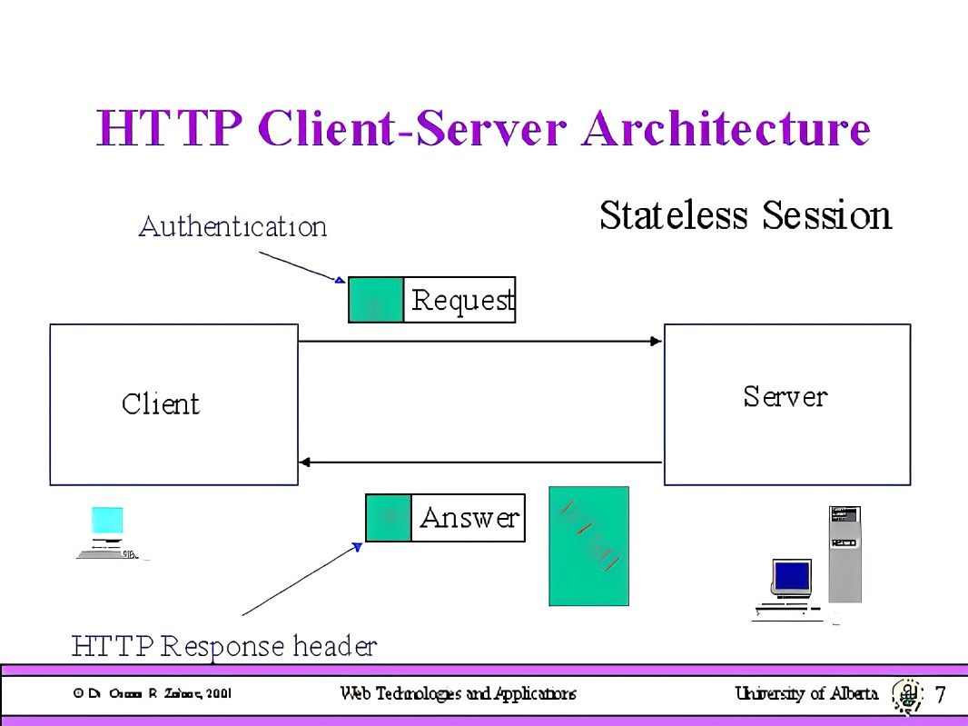

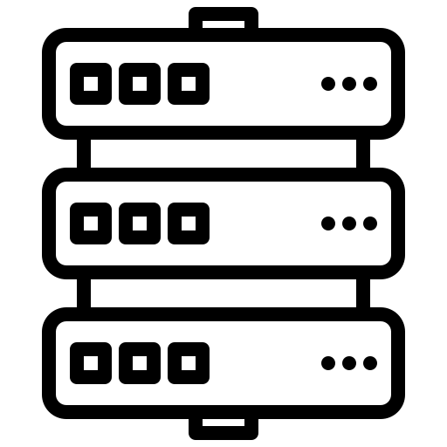
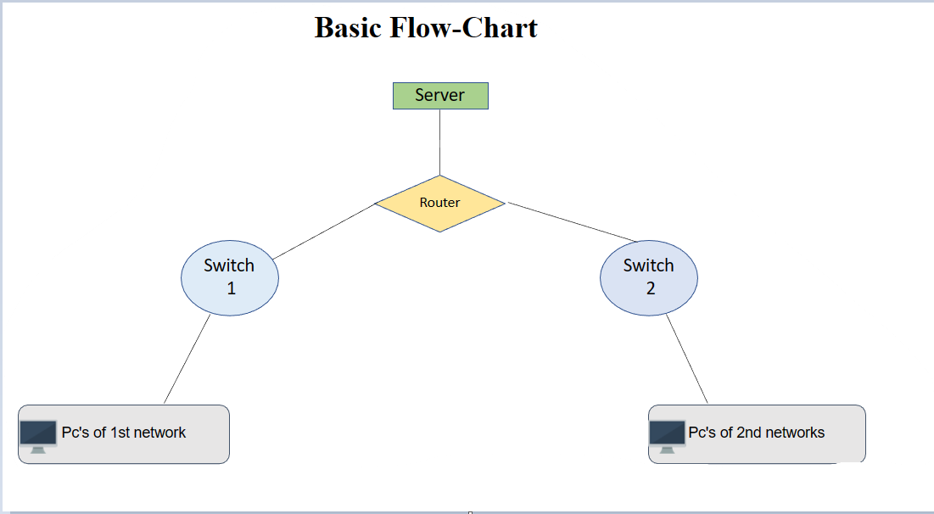

Email Configuration
Anchal| Swasti| Riya| Suksham
Abstract
HTTP Server Architecture
a mail server collects and distributes emails to their intended destination & also encrypt the transfer of emails, so nobody can gain access in personal email inbox. Whether we’re checking your emails from your phone, on the web, email is handled by both incoming and outgoing email servers.
In our project as we have connected every networking device in a same server and configure email among distributed network in such a way that we will pass an email from source to destination
mail will transfer in between sender and receiver and no other device connected to that network can access that mail.
Networking Device Used
1. PT-Router
2. Server
3. PT-switches
4. Computers
5. Connecting cables
Mail Service Architecture
Connecting Wire Used
1.Copper Straight through
2. Serial DTE/DCE
End Devices Used
1.PC’s
2.Server
Network Structure
Server Name:Gmail.com
1
IP Address:192.168.4.18
DNS Server
SMTP
SMTP
POP3
2
Incoming Server
Outgoing Server
Team- 4
.postersession.com www.postersession.com
www

